Slide 1
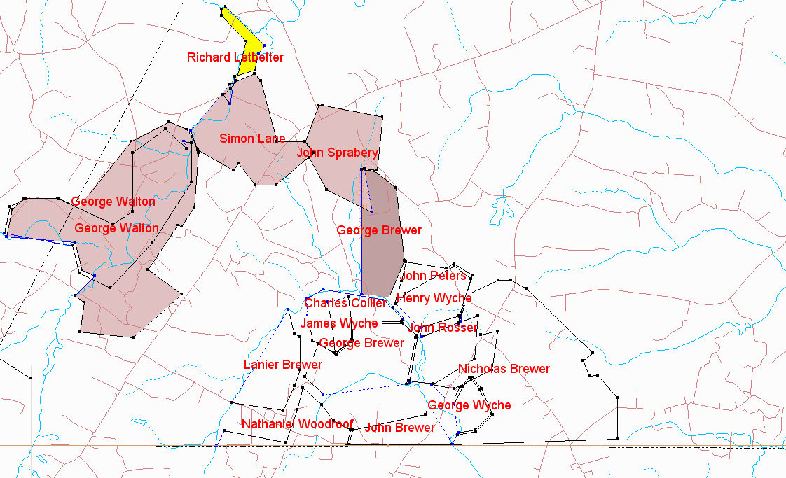
Rev. William Garner, Sr Neighboring Patents Greensville County, VA
William purchased 1070 A from John Sprayberry 1774 Included Simeon Lane patent land
Rosser 1785 patent which encompasses Garner’ Mill begins on northeastern point “at Garner’s small red oak” and abuts on east side land owned by HB and RH Garner, grandchildren of William
Nicholas Brewer patent encompasses land owned by owned by HB and RH Garner, grandchildren of William
Site of RB RH HB Garner and ancient plantation site
Note that Rev William’s daughters married Brewers Woodruffs and Norwoods

Slide 2
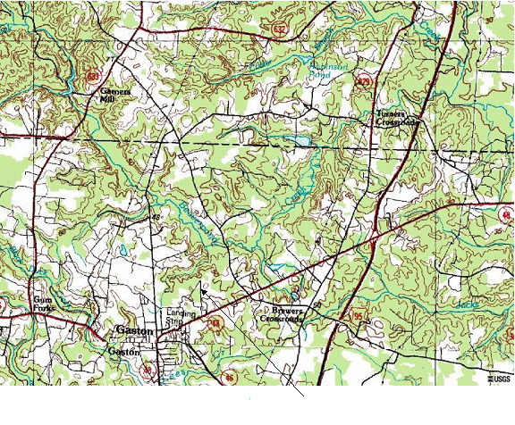
P K Garner
E I Thomas Cemetery
Henry
Garner Cemetery
P K Garner
E I Thomas Cemetery

Slide 3
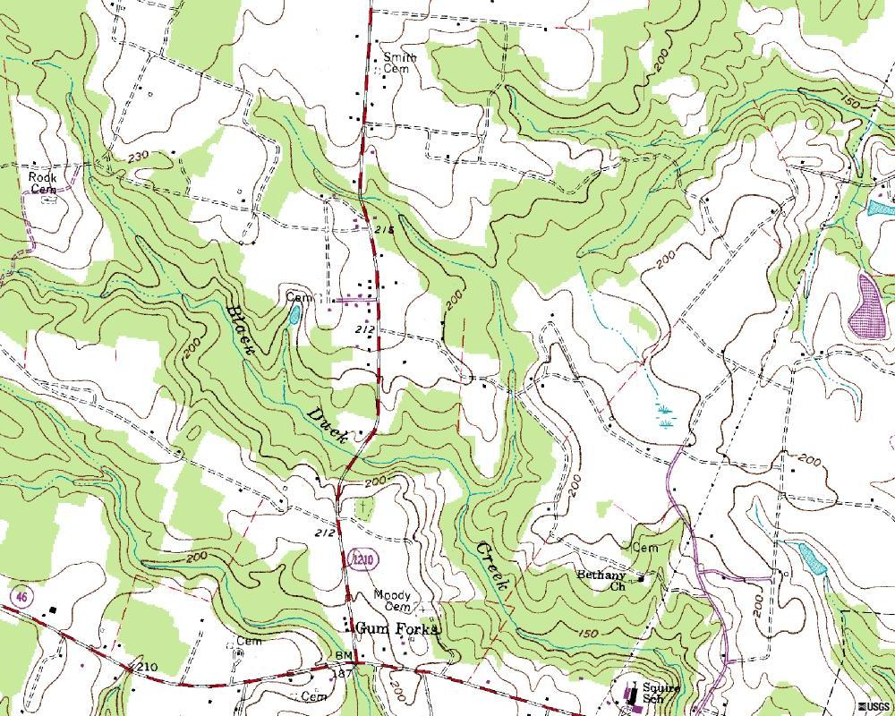
A

